Slide 1
ReliefXpert by Athletes
AI-Driven Personalized Pain Management with Real-Time Feedback and Relief Suggestions

Slide 2
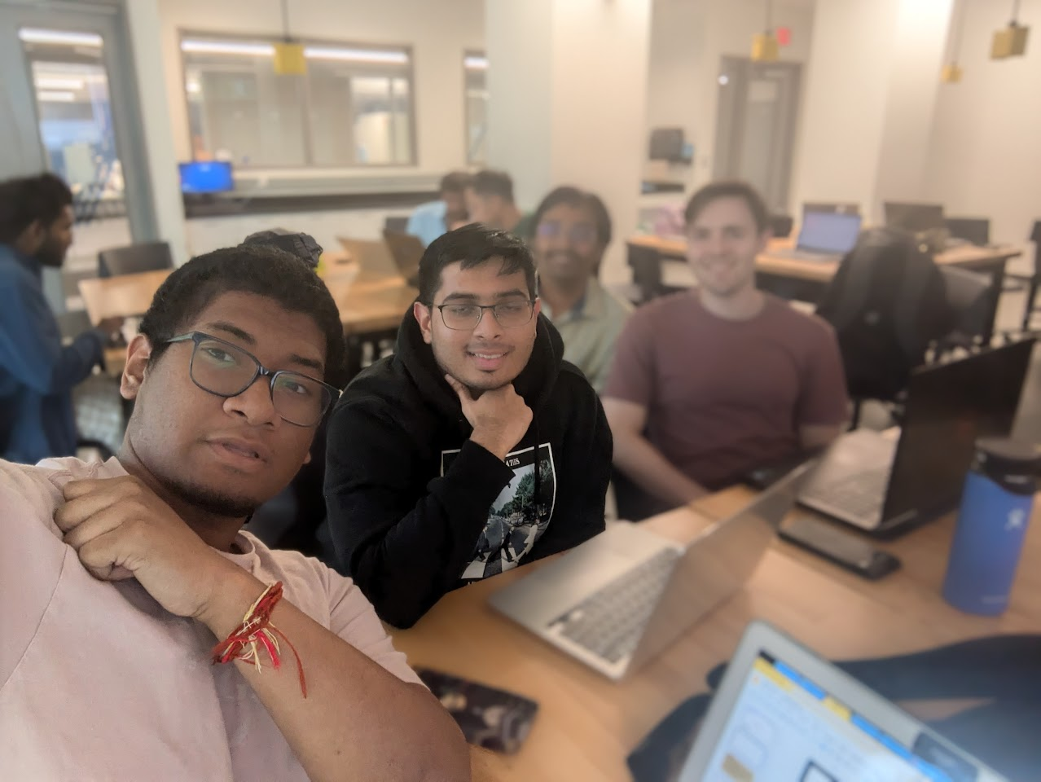
Team Members
Jainil Patel : AI/ML Specialist
Fine-tune machine learning models for detection
Cameron O’Dell: Front-End Dev
Develop and implement user interface and API interaction
Suryansh Patel: Project Manager / Full Stack
Oversee project timeline and ensure AI integration
Jacob Xayaphet: Data Analyst / UX Researcher
Analyze the performance of models and follow through with design based on user feedback

Slide 3
What’s the problem?
Develop an AI-powered tool that monitors exercise posture and provides real-time feedback to users while also managing and alleviating pain during workouts.
Key Features:
Real-time posture correction
AI-driven pain monitoring and relief suggestions
Personalised pain management plans

Slide 4
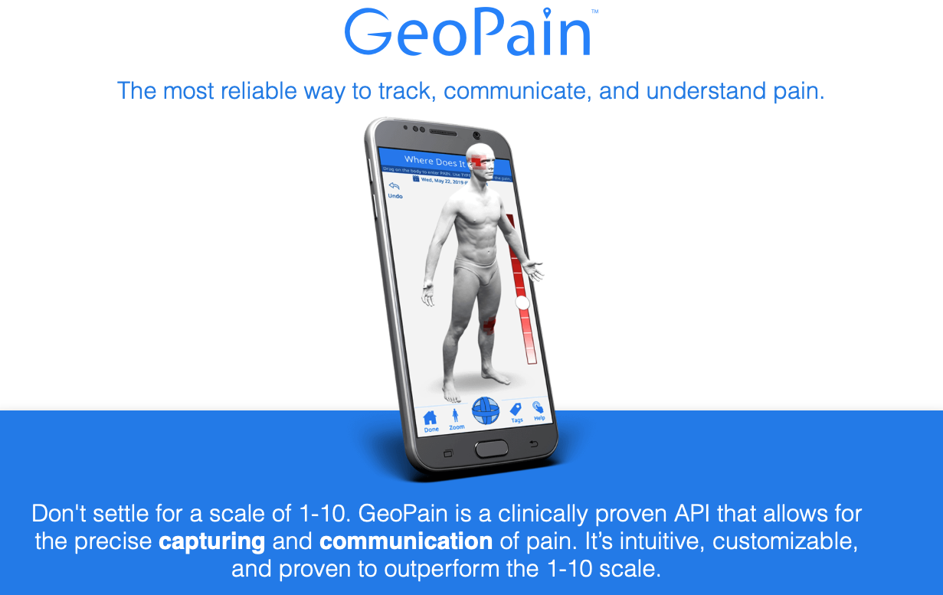
How computer locates pain?
We are planning to show the 3D model of the human to the user, and the user would be able to select the areas where he is getting the pain most.
Also we would be asking that which muscles the user thinks are getting the most workout during the exercise.
By this the database will contain the locations of the pain, which will be than given to the LLMs for further processing.
Image taken from internet.

Slide 5
Current Progress?
Able to connect and integrate triangle model
Our model works properly on one exercise which is squats
Using Ngrock we deployed and tested on other machines as well

Slide 6




Technology Used:

Slide 7
Triangle Model Implementation.

Slide 8
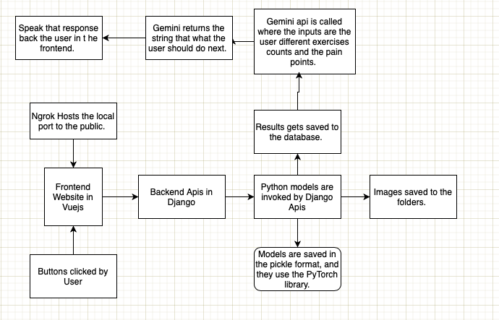
Triangle model
Frontend: Developed using Vue.js but planning to change, featuring a responsive design that supports various devices.
Data Repository: MongoDB stores unstructured data (images and annotations).
AI/ML Component: The model is implemented in Tensorflow, with real-time processing capabilities for exercise detection.

Slide 9
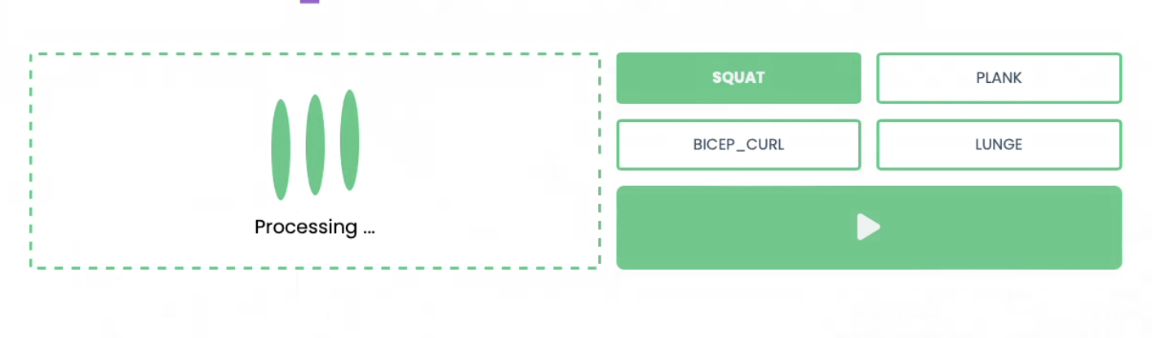
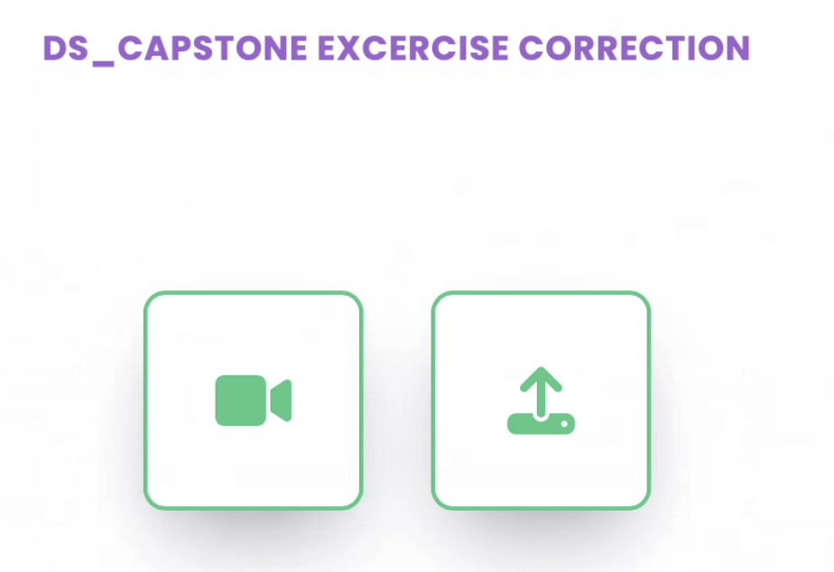
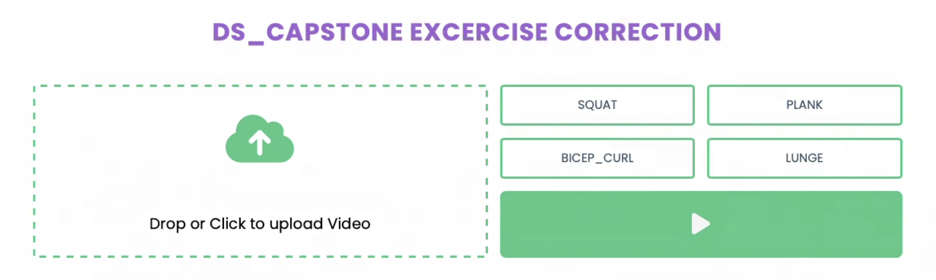
Current UI

Slide 10
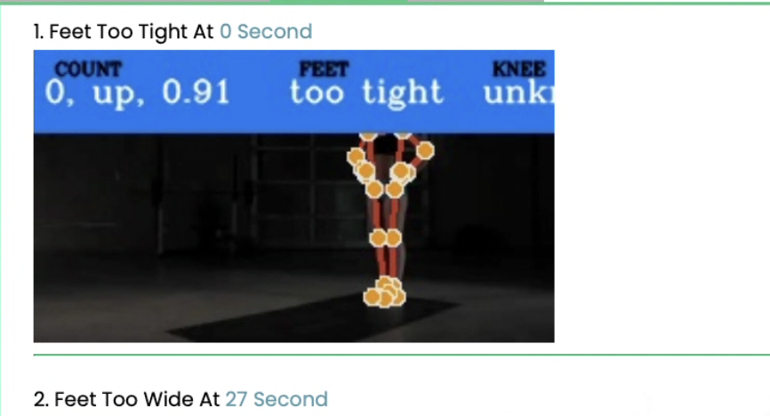
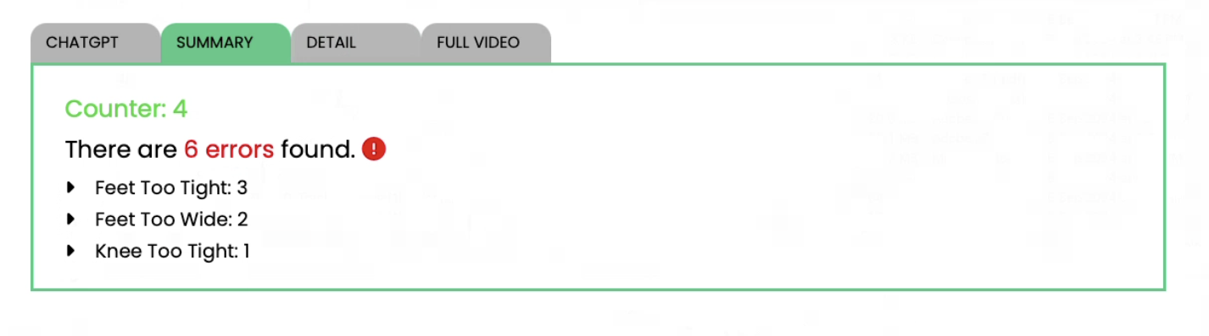
Results for Squats

Slide 11


…Could be too late to avoid

Slide 12

..Could be too late to avoid (cont)
Issues with “bro science” in training advice leading to conflicting advice on social media and articles
Niche workouts often don’t have many explanations of workout
Alternative adjustments to workouts not common when explaining a workout
Ways to understand whether a workout is being done wrong not always paired with explanation of workouts - worse as short form video popularizes more exercises

Slide 13
Future Work

Slide 14

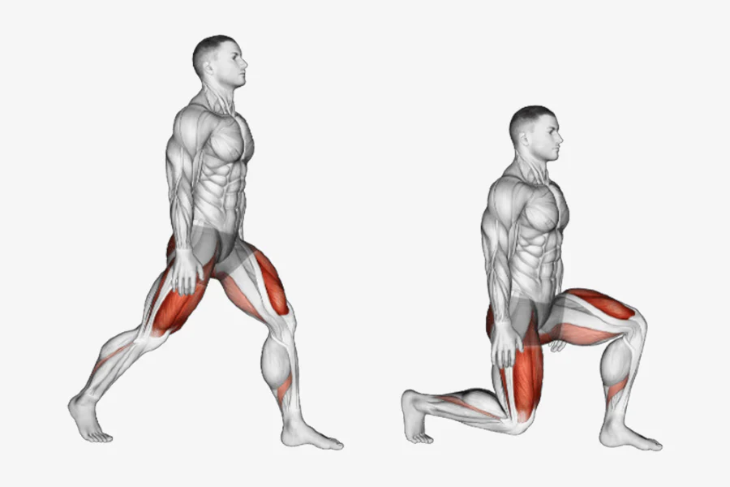
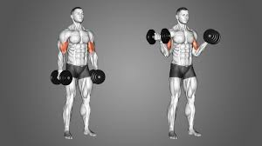
Future Steps:
We will be creating model for 3 other types of exercise which is:
Plank
Lunges
Bicep Curl

Slide 15
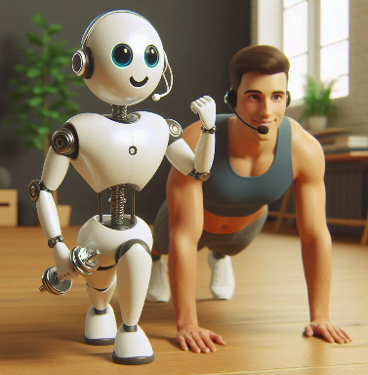
Next Steps
Conduct user testing to gather feedback on the frontend interface.
Refine the AI/ML model based on user interaction data.
Finalize the deployment strategy for the web application.

Slide 16
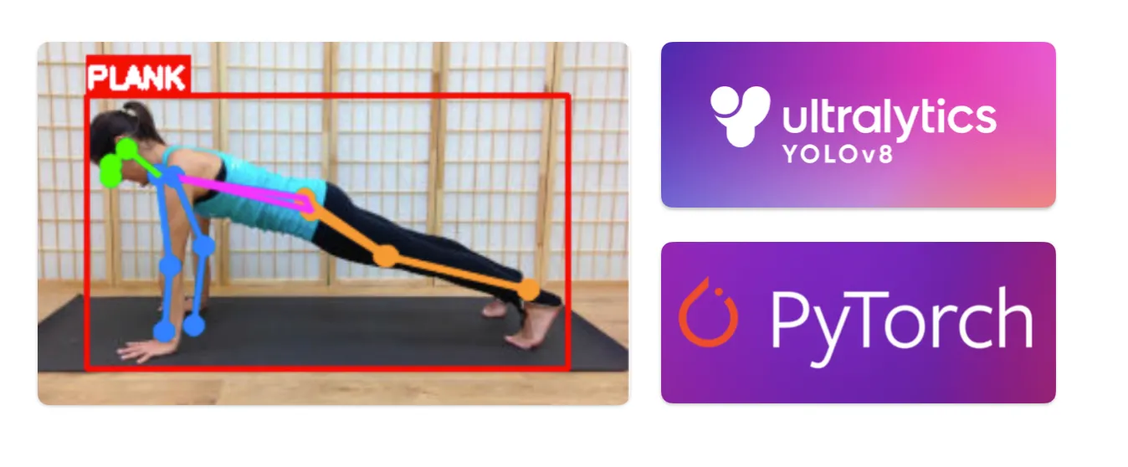
Real-time Feedback using Multi Modal Data
Using a simple camera, like a webcam or phone - provide real-time feedback!
Using Sentimental analysis form facial expressions
Using pre trained chatBot for suggestions and comments

Slide 17
Retrieval Augmented Generation (RAG) and LLM Feedback
We plan to use an LLM to provide text/audio feedback that is personalized to what the user is doing incorrectly in their exercise
Model will work with a corpus of data that includes exercise guidelines and research which our team will curate for more in-depth approach and guidance for the LLM
Example : user is feeling pain doing deadlifts, RAG retrieves relevant information from the corpus and provides feedback on improving form or recommending alternative exercises like kettlebell swings or hip thrusts that maybe easier to perform while working on the same muscle groups

Slide 18
Questions

Slide 19
Interview Questions
What technical challenges have you encountered during the development of the exercise detection model, and how have you addressed them?
How do you assess the effectiveness of the current AI/ML model in detecting exercise forms? Are there metrics you believe we should focus on?
What features do you think would enhance the user experience on the frontend? Are there any functionalities you feel are currently lacking?
How do you feel about the integration between the frontend and backend systems? Are there any pain points or areas for improvement?
What are your expectations for the next phase of the project? Are there any particular goals or deliverables you want to emphasize?

